Slide 1
HEART DISEASE PREDICTION USING MACHINE LEARNING
(18CSP301L) MINOR PROJECT - FINAL REVIEW
Name of the Candidates : MOHESHWARAN S
PRIYADHARSAN K
RAAJ GANESH S S
Register Numbers : 20BCB4022
20BCB4030
20BCB4031
Name of the Supervisor : Mrs.V.BANUPRIYA AP/CSBS
with Designation

Slide 2
Introduction
According to the World Health Organization, every year 12 million deaths occur worldwide due to Heart Disease.
The early diagnosis of heart disease plays a vital role in making decisions on lifestyle changes in high-risk patients and in turn reduces the complications.
Machine learning proves to be effective in assisting in making decisions and predictions from the large quantity of data produced by the health care industry. This project aims to predict future Heart Disease by analyzing data of patients which classifies whether they have heart disease or not using machine-learning algorithm.
By collecting the data from various sources, classifying them under suitable headings & finally analysing to extract the desired data we can say that this technique can be very well adapted to do the prediction of heart disease.

Slide 3
Problem Statement
The major challenge in heart disease is its detection. There are instruments available which can predict heart disease but either it are expensive or are not efficient to calculate chance of heart disease in human. Early detection of cardiac diseases can decrease the mortality rate and overall complications. However, it is not possible to monitor patients everyday in all cases accurately and consultation of a patient for 24 hours by a doctor is not available since it requires more sapience, time and expertise. Since we have a good amount of data in today’s world, we can use various machine learning algorithms to analyze the data for hidden patterns. The hidden patterns can be used for health diagnosis in medicinal data.

Slide 4
Abstract
Machine Learning is used across many ranges around the world. Machine Learning can play an Essential role in predicting presence/absence of locomotors disorders, Heart diseases and more. Such information, if predicted well in advance, can provide important intuitions to doctors who can Then adapt their diagnosis and dealing per patient basis. We work on predicting possible Heart Diseases in people using Machine Learning algorithms. In this project we perform the comparative Analysis of classifiers like decision tree, Naïve Bayes, Logistic Regression, SVM and Random Forest And we propose an ensemble classifier which perform hybrid classification by taking strong and Weak classifiers

Slide 5
Objectives of the Project
Heart disease is even being highlighted as a silent killer which leads to the death of a person without obvious symptoms. The nature of the disease is the cause of growing anxiety about the disease & its consequences. Hence continued efforts are being done to predict the possibility of this deadly disease in prior. So that various tools & techniques are regularly being experimented with to suit the present-day health needs. Machine Learning techniques can be a boon in this regard. Even though heart disease can occur in different forms, there is a common set of core risk factors that Influence whether someone will ultimately be at risk for heart disease or not. By collecting the data from various sources, classifying them under suitable headings & finally analysing to extract the desired data we can conclude. This technique can be very well adapted to the do the prediction of heart disease. As the well-known quote says “Prevention is better than cure”, early prediction & its control can be helpful to prevent & decrease the death rates due to heart disease.

Slide 6
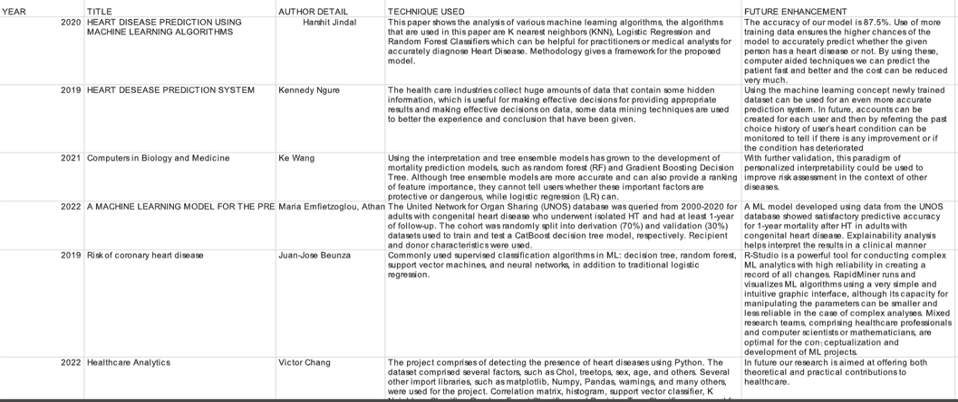
Literature Survey

Slide 7
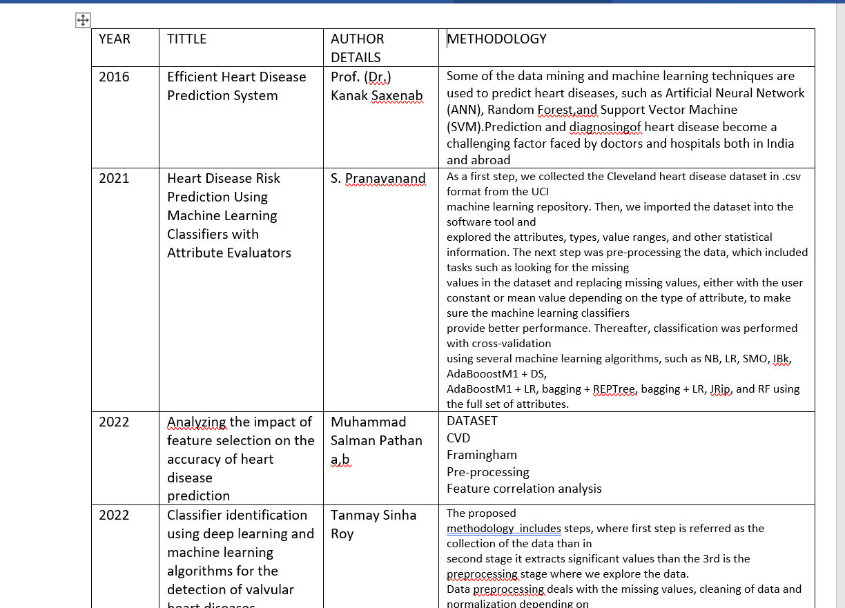

Slide 8
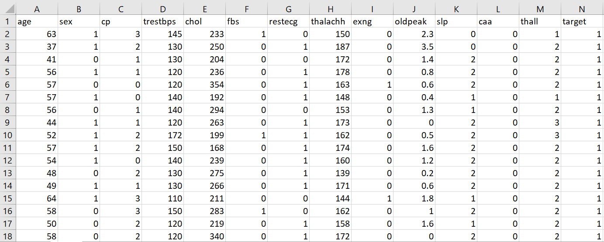
Data Set

Slide 9
System Architecture
The working of this system is described as follows:
Dataset collection is collecting data which contains patient details. Attributes selection process selects the useful attributes for the prediction of heart disease. After identifying the available data resources, they are further selected, cleaned, made into the desired form. Different classification techniques as stated will be applied on preprocessed data to predict the accuracy of heart disease. Accuracy measure compares the accuracy of different classifiers.

Slide 10
Existing System Architecture
KNN
Dataset
Data
pre-processing
Classification
Accuracy
LR
Disease
prediction

Slide 11
Proposed System Architecture
Dataset
Attribute
selection
Pre-processing
Of data
Classification
techniques
LR
RF
GB
KNN
DT
SVM
Patient
details
Disease
Prediction
Accuracy
Measure

Slide 12
Modules in Project
Attribute Selection
Analysis of Algorithm
Heart Disease Prediction

Slide 13
Summary of Attribute Selection
Attribute or Feature selection includes the selection of appropriate attributes for the prediction system.
This is used to increase the efficiency of the system.
Various attributes of the patient like gender, age, cerebral palsy, cholesterol,
restecg etc.. are selected for the prediction.

Slide 14
Summary of Analysis of Algorithm
Various machine learning algorithms like SVM, Linear Regression, Decision Tree, Random Forest, Logistic Regression and Gradient Boosting are used for classification.
By comparative analysis which is performed among algorithms and concluded that Logistic Regression gives more accuracy.

Slide 15
Summary of Heart disease prediction
Through this, the outcome of the project will be predicted
Whether the person having heart disease or not

Slide 16
Software & Hardware Requirements Specification
HARDWARE REQUIREMENT
System – i3 processor
RAM – 4GB
Hard Disk – 500 GB
SOFTWARE REQUIREMENT
Operating System – Windows 10
Coding language – Python 3.8
Web Framework - Tkinter

Slide 17
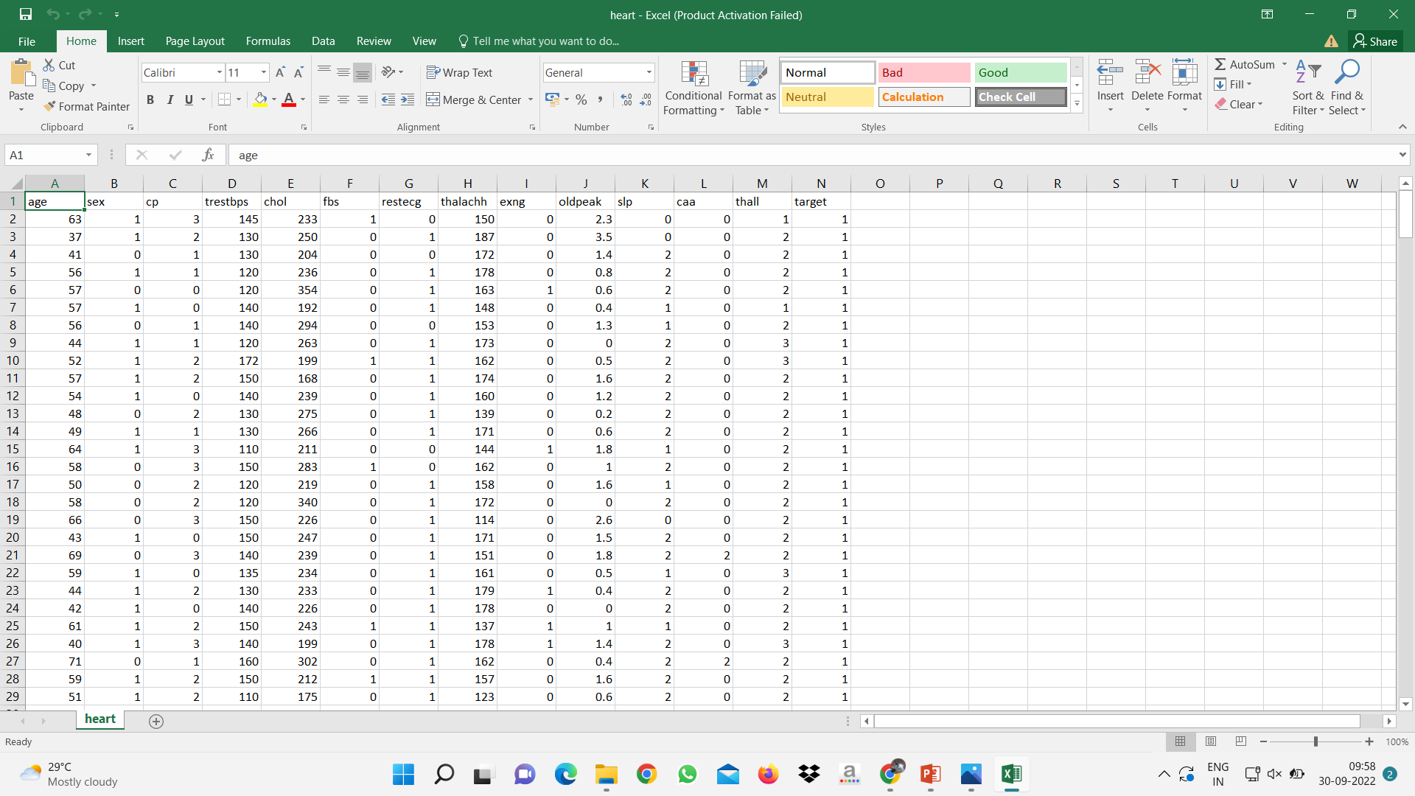
Implementation of Attribute Selection Module

Slide 18
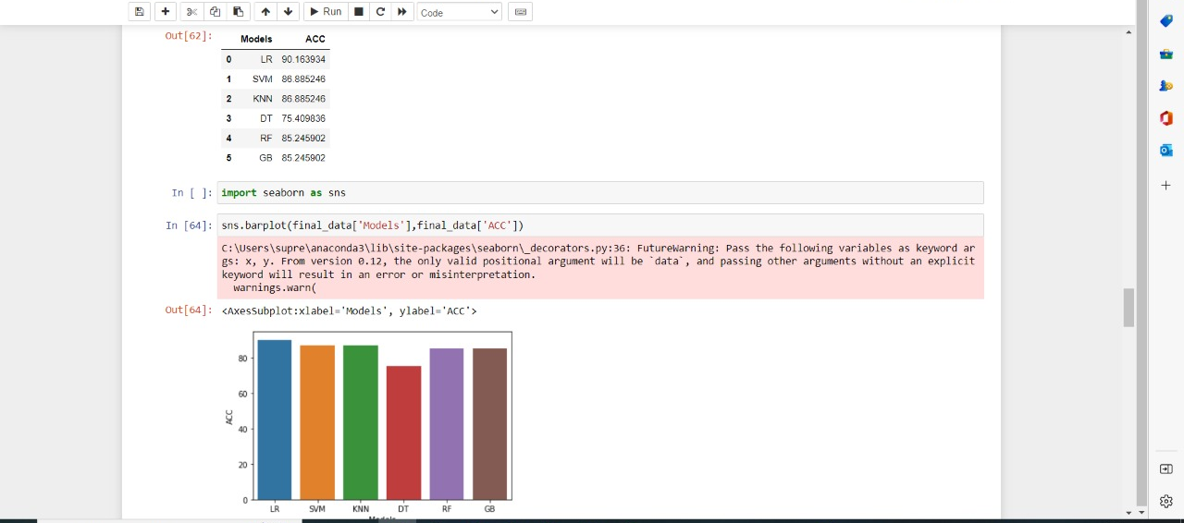
Implementation of Analysis of Algorithm Module

Slide 19
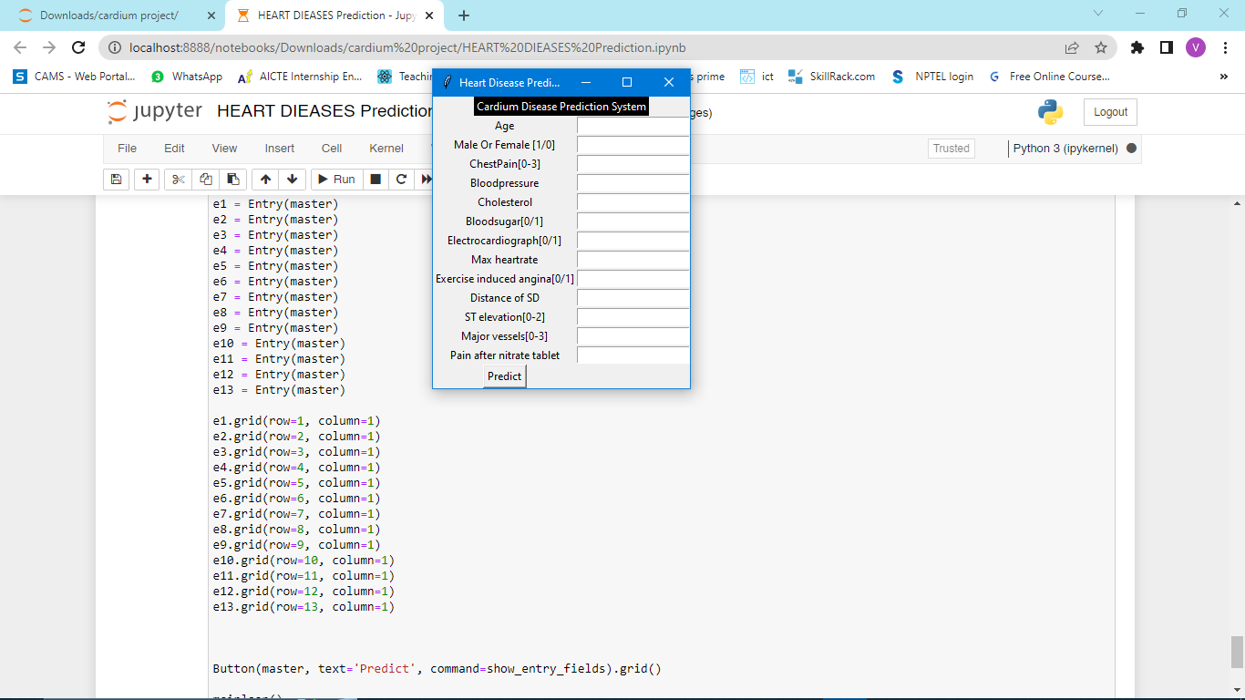
Implementation of Completed Modules

Slide 20
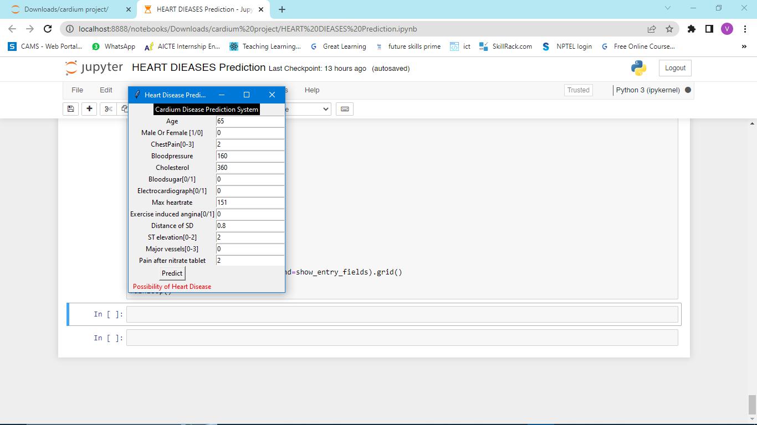
Demo of Implementations Modules

Slide 21
Conclusion
Heart disease is one of the major concerns for society today.
It is difficult to manually determine the odds of getting heart disease based on risk factors.
However, machine learning techniques are useful to predict the output from existing data.
“Remember that prediction is far much better than cure!!”

Slide 22
THANK YOU

